Slide 1

Dates and Times
How hard can it be?!

Slide 2
Date Time Falsehoods
There are always 24 hours in a day
There are always 365 days in a year
Time always goes forwards

Slide 3
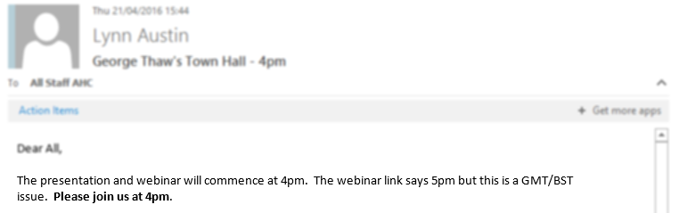

Slide 4
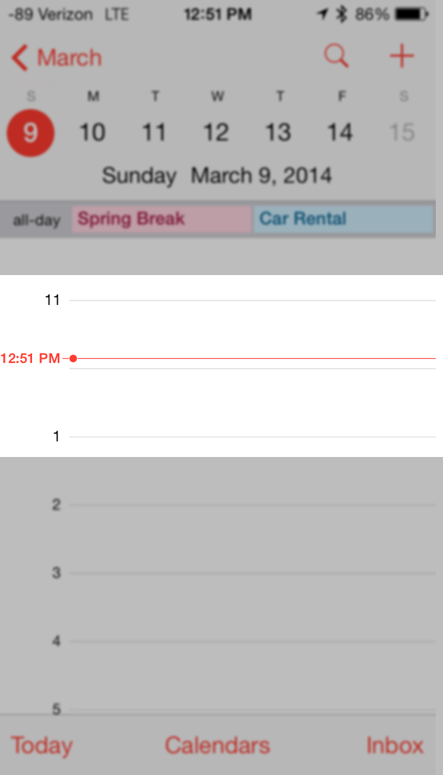

Slide 5
Even in our own codebase!
var now = DateTime.Now;
var lastYear = new DateTime(
year: now.Year - 1,
month: now.Month,
day: now.Day);

Slide 6
2016-04-28 15:30:01

Slide 7
2016-04-28 15:30:01
Date Part

Slide 8
2016-04-28 15:30:01
Time Part

Slide 9





Title and Content Layout with List
Issues with having just Date & Time
I’ll call you on 1st May at 1 PM
OK

Slide 10


Title and Content Layout with List
Issues with having just Date & Time
May 1st
13:00:00
May 1st
06:00:00
Where are you?!
Zzzzz….

Slide 11
Issues with having just Date & Time
How could we make sure they schedule the call to happen simultaneously in both countries?
We know that Colarado local time is 7 hours behind the local time in the UK, so actually the American should have been expecting the call at 13:00 - 7 hours = 06:00
Here, we’ve used a reference timeline (UK) and adjusted the Colarado local time accordingly
But in the UK and America we adjust our local times for daylight savings (at different times), which means that the difference is not constant

Slide 12
Enter UTC
Coordinated Universal Time
The primary time standard by which the world regulates clocks and time
Does NOT observe daylight saving time
Expressed as
2016-04-29 12:30:00 +00:00 OR
2016-04-29 12:30:00 Z

Slide 13
Title and Content Layout with List
UTC… Yay!
I’ll call you on 1st May at 1 PM UTC
OK

Slide 14
UTC… Yay!
May 1st
14:00:00
(13:00:00 UTC)
May 1st
07:00:00
(13:00:00 UTC)
Do you know how early it is here?!
Hi

Slide 15
Date Time Offset
2016-05-01
13:00:00 +01:00

Slide 16
Date Time Offset
2016-05-01
13:00:00 +01:00

Slide 17
Date Time Offset
… 13:00:00 +00:00
… 14:00:00 +01:00
… 06:00:00 -07:00

Slide 18
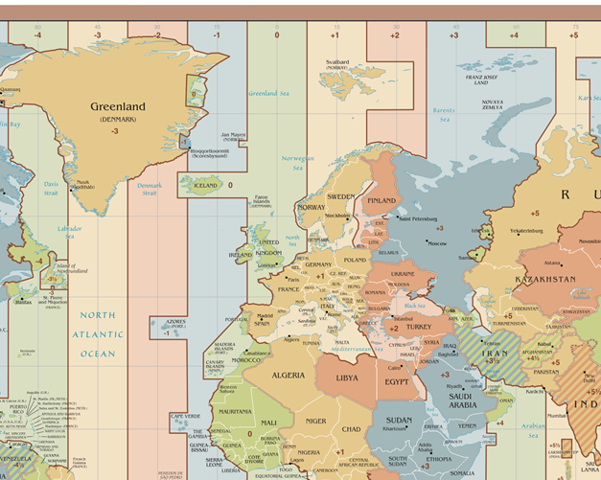
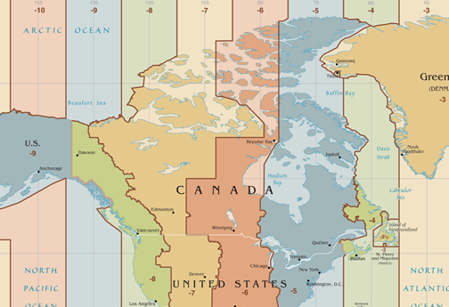
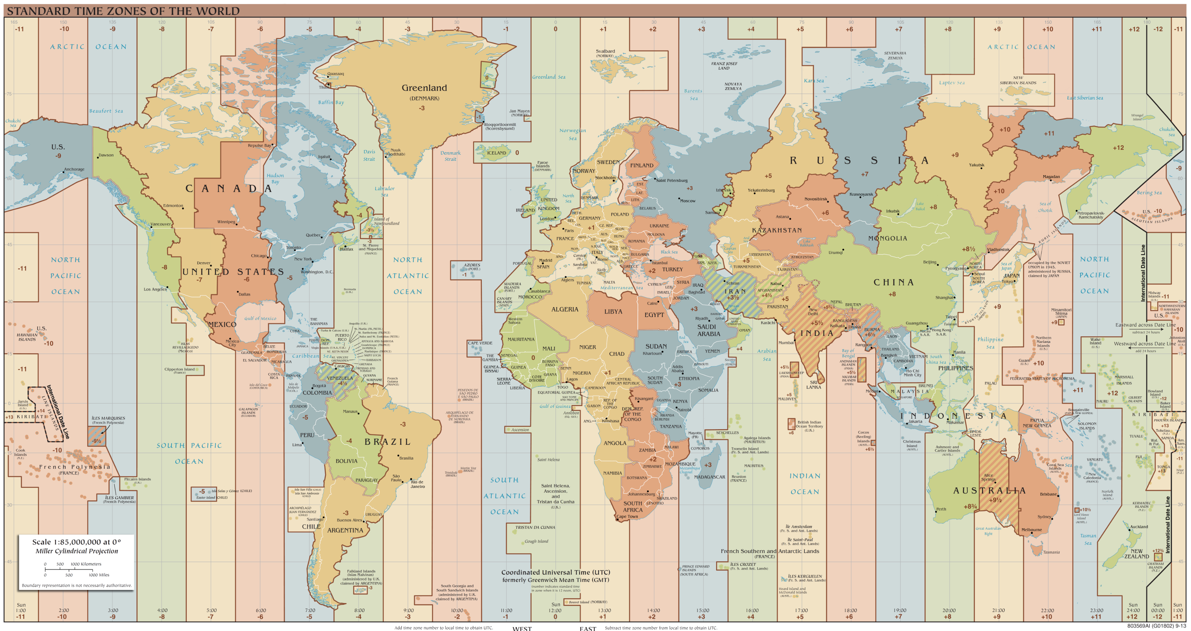
Time Zones

Slide 19
Daylight Savings

Slide 20
Daylight Savings

Slide 21
Daylight Savings

Slide 22
Daylight Savings

Slide 23
Daylight Savings
How many hours are there between 00:00 and 03:00 ?

Slide 24
.NET Date Time Offset
Plus 1 hour
01:30:00 +01:00
02:30:00 +01:00
01:30:00 +00:00

Slide 25
Conversions
(DateTimeOffset UTC)
UTC Local
Local UTC

Slide 26
.NET TimeZoneInfo
public static DateTimeOffset ConvertTime(
DateTimeOffset dateTimeOffset,
TimeZoneInfo destinationTimeZone)
public static DateTime ConvertTime(
DateTime dateTime,
TimeZoneInfo sourceTimeZone,
TimeZoneInfo destinationTimeZone)

Slide 27
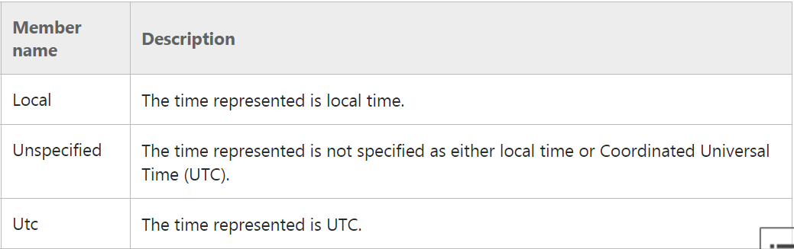

.NET DateTimeKind
“The Kind property allows a DateTime value to clearly reflect either Coordinated Universal Time (UTC) or the local time.

Slide 28
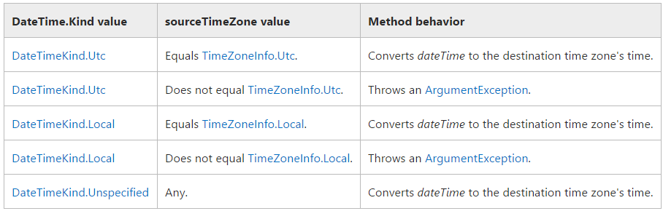
.NET TimeZoneInfo
TimeZoneInfo.ConvertTime Method (DateTime, TimeZoneInfo, TimeZoneInfo)
The value of the Kind property of the dateTime parameter must correspond to the sourceTimeZone parameter, as the following table shows.

Slide 29
.NET TimeZoneInfo
TimeZoneInfo.ConvertTime Method (DateTime, TimeZoneInfo, TimeZoneInfo)
What about 01:30 when there are two?
What about 01:30 when 01:30 does not exist?
If the value of the dateTime parameter is an ambiguous time in the source time zone, it is interpreted as a standard time.
If the dateTime parameter is an invalid time in the source time zone, this method throws an ArgumentException.

Slide 30
Noda Time
“Local” types
“Global” types
Important to know source of the date/time
LocalDateTime (LocalDate + LocalTime)
Instant
ZonedDateTime

Slide 31
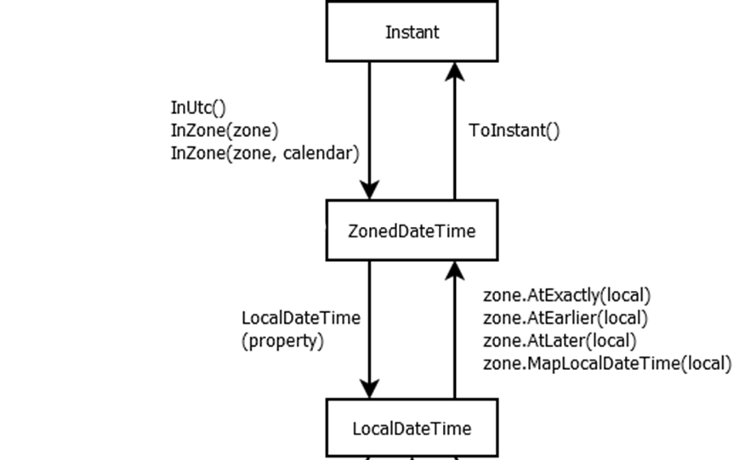

Slide 32
Noda Time Zones
LocalDateTime:
public ZonedDateTime InZone(
DateTimeZone zone,
ZoneLocalMappingResolver resolver
)

Slide 33

Noda Time ZoneLocalMappingResolver
public ZonedDateTime InZone(
DateTimeZone zone,
ZoneLocalMappingResolver resolver
)
“What is this local date and time in time zone X?”
If the local date and time is ambiguous then do A
If the local date and time is missing (invalid) then do B

Slide 34
Example
var shiftStart = shift.StartTime
.On(shiftStartDate)
.InZone(
timeZone,
DateTimeRules.StandardZoneLocalMappingResolver)

Slide 35
How we process date times from the user
1. User selects
29 April @ 2:30 PM
2. Sent to server:
“2016-04-29 14:30:00 +07:00”
3. Server maps
2016-04-29 14:30:00 +07:00
To a DateTimeOffset
4. We can then see the
date/time the user intended:
2016-04-29 14:30:00 +07:00
5. We then have a local date time of
2016-04-29 14:30:00

Slide 36
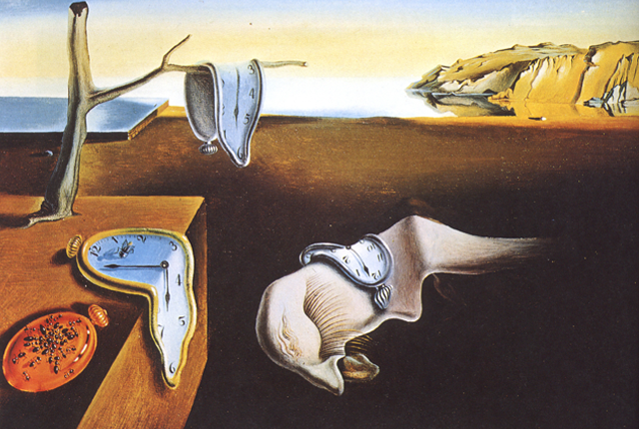
Fin.

